Slide 1

Mediator Design Pattern in Java

Slide 2
What are design patterns?
Design patterns are reusable solutions to common software design problems.
They act as blueprints and show how to solve problems without giving exact code.
Unlike algorithms, patterns focus on structure and relationships rather than step-by-step logic.
Benefits of patterns
Design patterns provide tested solutions to common software problems.
Learning patterns helps you apply object-oriented principles to various problems.
They create a common language for efficient communication among team members.
Classification
Creational patterns: Simplify and enhance flexibility in object creation.
Structural patterns: Focus on organizing classes and objects into efficient structures.
Behavioral patterns: Manage communication and responsibility assignments between objects.

Slide 3
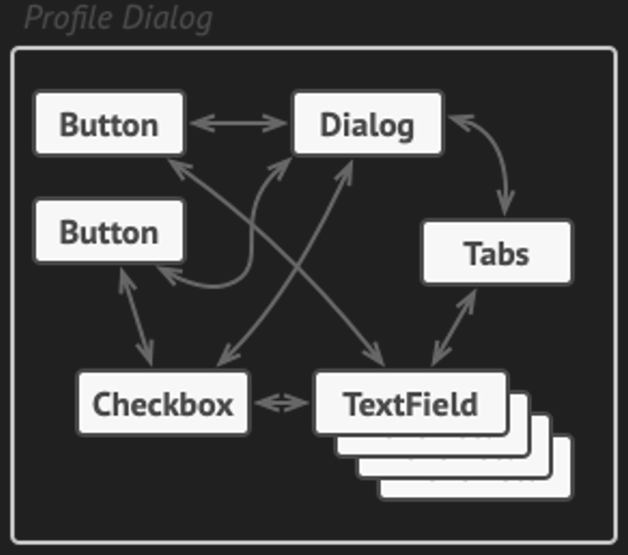
Mediator Design Pattern
Behavioral design pattern that lets you reduce chaotic dependencies between objects.
Restricts direct communications between the objects and forces them to collaborate only via a mediator object.
Problem
A customer profile form has elements like text fields, checkboxes, and buttons.
Some elements interact, e.g., selecting "I have a dog" reveals a hidden text field for the dog's name.
If interaction logic is inside form controls, they become tightly coupled and hard to reuse.
Example: The checkbox class depends on the text field class, making reuse difficult in other forms.

Slide 4
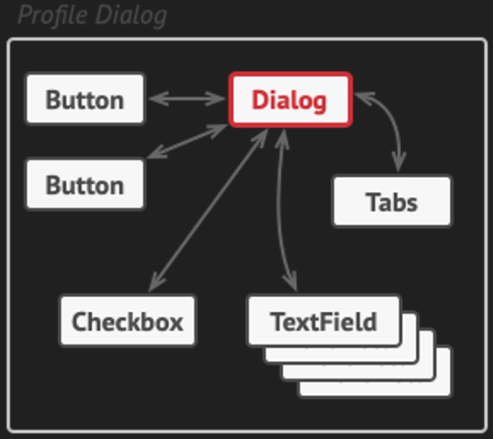
Solution
The Mediator pattern removes direct communication between components.
Form elements (checkbox, text field, button) communicate through a mediator object that manages interactions.
In this example, the dialog class acts as the mediator. It handles communication between form elements.
Instead of the checkbox modifying the text field, it notifies the dialog, which updates the form.
This makes form elements independent and reusable. Also, improving flexibility and ease of modification.
Real World Analogy
Pilots don’t communicate directly with each other but through an air traffic controller. That ensures the safe coordination.
Similarly, the Mediator pattern helps components communicate through a central mediator which makes the interactions easier.

Slide 5
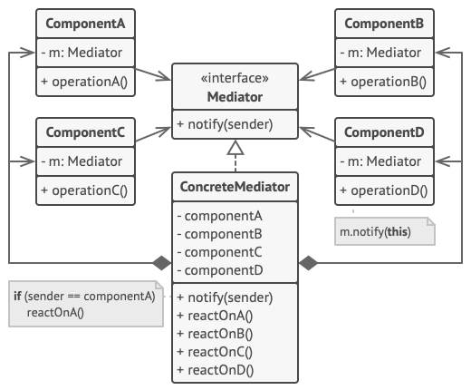
Structure of Mediator Design Pattern

Slide 6
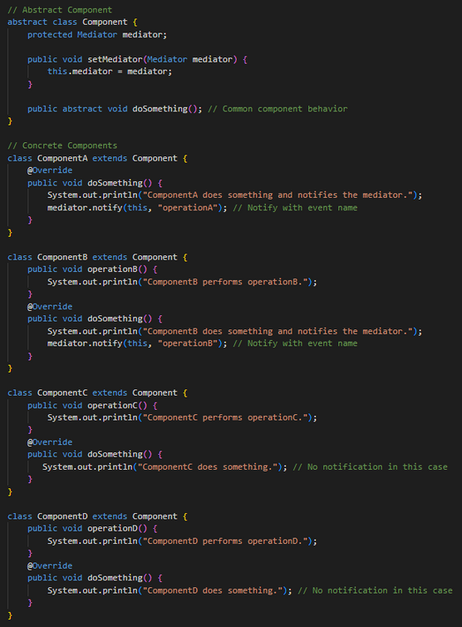
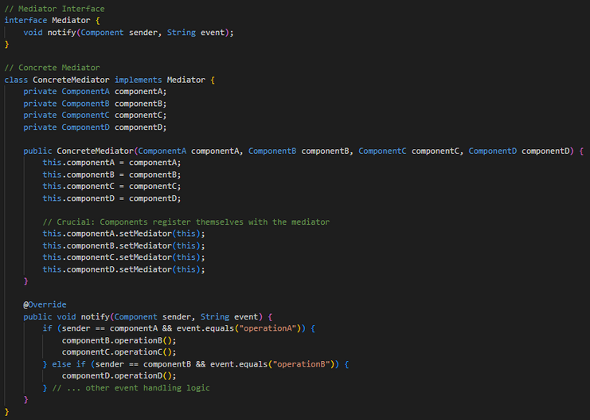
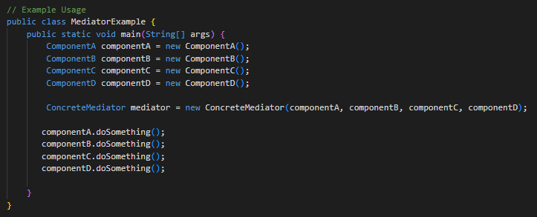
Code Example

Slide 7
Applicability
Use the Mediator pattern when classes are tightly coupled and difficult to modify.
Use the Mediator pattern to isolate relationships between classes for better reusability.
Use the Mediator pattern to change how components interact without modifying them.
Reference
Refactoring Guru. (n.d.). Design Patterns.
https://refactoring.guru/design-patterns

Slide 8
Thank you

